Slide 1
Electoral systems

Slide 2
First Past Post…
Division into districts
Every voter chooses their top candidate
Usually--whichever candidate receives the most votes, wins (plurality)
Sometime—whichever candidate receives the majority of votes, wins (majority)
This will require a run-off election between two candidates if no one gets a majority

Slide 3
First Past Post…. (Winner take all)
Positives
Creates stability with one party in charge of legislature, or government (parliamentary systems)
Creates broad parties reflecting a large cross-section of the public
Creates two dominant parties that compete for centrist voters
System is easy to understand, implement and inspect
Direct accountability to electorate
Criticisms
Does not reflect the wide spectrum of voter issues and interests
Larger parties and parties with broad appeal and support get a disproportionate share of the seats in government (often does not reflect popular vote)

Slide 4
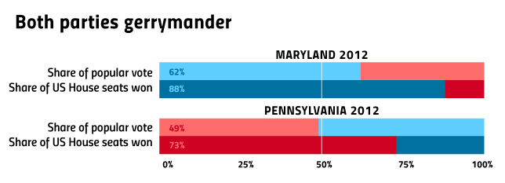

Slide 5
First Past Post….
Seats Parties with over one seat, for Great Britain only |  | Seats % | Votes % | Votes
Labour Party | 355 | 56.5 | 36.1 | 9,552,436
Conservative Party | 198 | 31.5 | 33.2 | 8,782,192
Liberal Democrats | 62 | 9.9 | 22.6 | 5,985,454
Scottish National Party | 6 | 1.0 | 1.6 | 412,267
Plaid Cymru | 3 | 0.5 | 0.7 | 174,838
Others | 4 | 0.6 | 5.7 | 1,523,716
628 |  |  |  | 26,430,908

Slide 6
Proportional representation…
People vote for their party OR candidate
(or both—Mexico) and the legislative seats are assigned according to percentage of vote
There is usually a threshold, ie. If you have less than 5% of the vote, your seats go to the leading party (Russia changed from 5 to 7 and then back to 5 to solidify United Russia’s position)

Slide 7
Proportional Representation
Positives
Theory is increased voter turnout
More accurately represents the results of the popular vote
Creates more parties with more specific platforms/goals
More parties leads to more collaboration on legislation
Complaints
Instability—in parliamentary democracies, coalition governments are more likely
In presidential democracies, it can confuse agenda or legislature
Calculation and transparency can be more difficult….
Less direct accountability to constituents

Slide 8
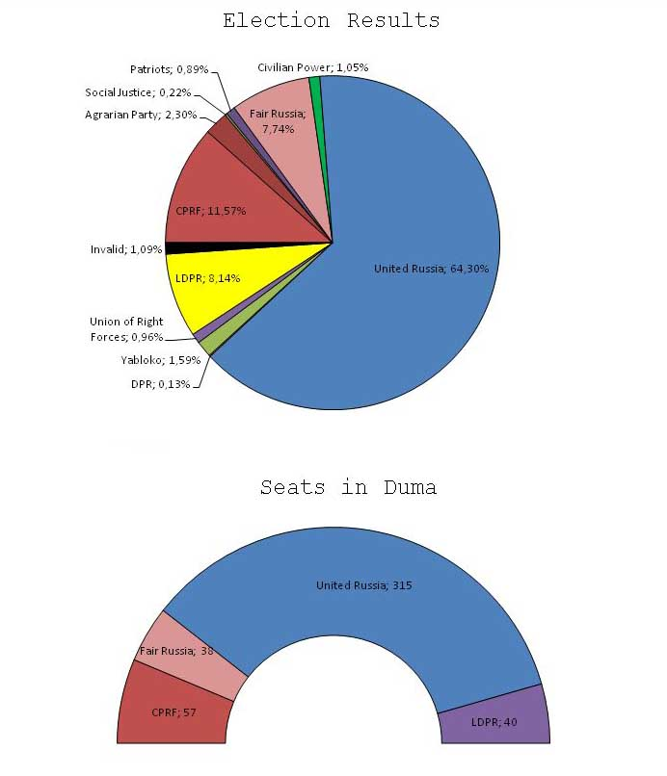
Proportional Representation
Russia, 2017

Slide 9
Generally, how does the electoral system influence the political parties that form?

Slide 10
Great Britain
House of Commons
650 members
Individual districts, first past post system
Candidates selected by the party to run in each district (no necessarily from district)
Fixed term parliament act of 2011 means cannot serve MORE than 5 years
House of Lords
Currently 788 seats-not fixed
Members are appointed
Lords spiritual (26 appointed by church of England)
Lords temporal (90 inherited, others appointed by Queen or government)
Formerly all were inherited
Only upper house larger than lower house, much less power than Commons

Slide 11
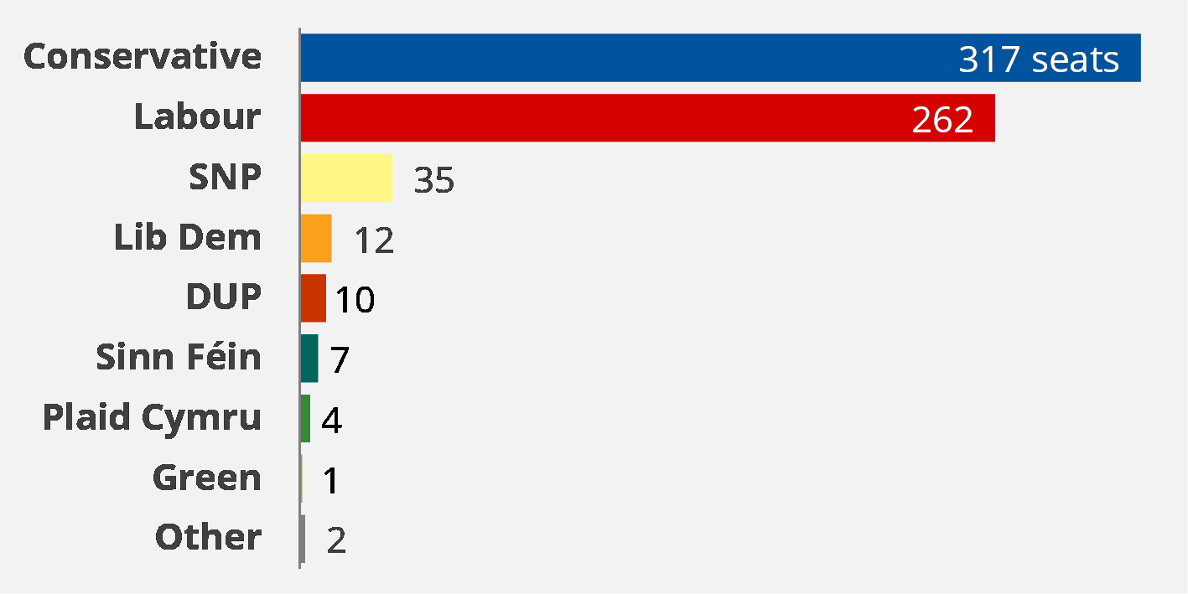
Great Britain--Parties
Two Dominant Parties
Labour
Conservative & Unionist
Regional Parties
Scottish National Party
Democratic Unionist Party (pro-protestant and UK Irish party)
Sinn Fein (largest Irish nationalist party)
Plaid Cymru (Welsh nationalist party)
Other Parties
Liberal-Democrats
Green Party

Slide 12
Great Britain-Legislative Powers
Bicameral
Lower house elected, upper appointed
Commons
Approves legislation
Votes for prime minister (appointed by monarch)
Lords
Review and amend bills from the Commons (power check)

Slide 13
Nigeria
House of Representatives
360 members
Elected by single district first past post constituencies (4 year terms)
Districts based on population
Senate
109 members
3 each from 36 regions, elected by 3 districts per region, first past the post
and 1 senator for capital region

Slide 14
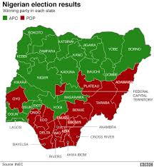
Nigeria—Political Parties
Major two parties
People’s Democratic Party (PDP)—99-15
All Progressives Congress (APC)—15-present
Buhari’s party
Made up from combination of 4 former parties
Other parties
African Democratic Congress (Obasanjo helped create)
African Action Congress
African Democratic Party
Zenith Labor Party
68 registered political parties….

Slide 15
Nigeria—legislative powers
Bicameral
Both chambers can approve legislation
Senate
Impeachment powers
Confirmation powers

Slide 16
Mexico
Chamber of deputies—500 members
300 single seat deputies by district plurality
From 32 districts
Based on population
200 selected by proportional representation
5 multi-seat regions
Chamber of Senators—128 members
96 from 32 districts (3 each)
2 for lead party, 1 for 2nd party in district
Remaining 32 seats by proportional representation nation-wide

Slide 17
Mexico—Political Parties
Major
Institutional Revolutionary Party (PRI)
National Action Party (PAN)
Democratic Revolutionary Party (PRD)
Others
Labor Party
Green Party
New Alliance Party
Citizens Movement Party
National Regeneration Party
Social Encounter Party

Slide 18
Mexico—Legislative Powers
Bicameral
Deputies
Approve legislation
Levy taxes
Approve spending
Verifies elections
Senate
Confirms presidential appointments (Supreme Court, judges)
Approves treaties
Approves federal intervention in state matters

Slide 19
Overall, independent legislatures can reinforce legitimacy and stability by:
responding to public opinion/ demand
openly debating policy
facilitating compromise between factions
Extending civil liberties
Restricting the power of the executive

Slide 20
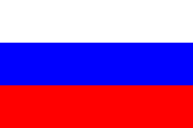
Russia
State Duma
450 members
Voting every 5 years in each of the 85 regions (unless new vote called)
225 are elected through regional single seat first past post voting
225 elected through proportional representation (5% threshold)
From 2005-2014 was only proportional representation and 7% threshold (2007 & 2011 elections)
Federation Council
170 members (2 from each of 85 regions/federal subjects)
“sent” by governors of federal subjects, not elected

Slide 21
Russia-Political Parties
United Russia
Putin’s Party
Control 315/450 Duma Seats
Real Opposition Parties
Communist Party of Russia (Zyuganov) 57 seats
Liberal Democratic Party (Zhironovsky) 40 seats)
A Just Russia (38 seats)
Other Parties
Yabloko
Right Cause (Prokhorov…)
Patriots of Russia (business...)

Slide 22
Russia-Legislative Powers
Bicameral
Upper house appointed, lower house elected
Duma
Passes legislation
Confirms prime minister (NOT presidential cabinet)
Approves budgets
Federation Council
Approves budgets
Approves treaties
Approves judicial nominees
Approve troop deployments

Slide 23
Iran
Majlis
290 members, 4 year terms [8% women (13% global average)]
202 constituencies by population (from 368 Shahrestans). Tehran has the most at 30 seats, next largest is 6)
5 constituencies by minority/special status groups
two seats to Armenian Christians
one to Assyrian and Chaldean Christians
one to Jews
one to Zoroastrians
Iran’s largest religious minority, Baha’i, is not officially recognized and is not granted a seat
Single and multi-member districts within voting districts, plurality rule IF at least 25% of total vote received, if not, run-off
Steady decline in number who are clerics (133 in ‘79 to 33 in ‘16)

Slide 24
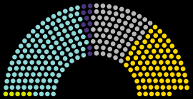
Iran-Political Parties
People’s Voice, Nation’s Voice (purple)
Pervasive Coalition of Reformists (aqua)
Minority groups (green)
Independents (grey)
Principlists Grand Coalition (yellow)

Slide 25
Iran-Legislative Powers
Majles is unicameral
Guardian Council
Body acts under supervision of the Guardian Council to ensure compatibility with Islam and Sharia law
When there is a conflict between Majles and Guardian Council, it is settled by the Expediency Council (appointed by Supreme Leader)
Guardian Council vets candidates for Majles
Body can
Approve legislation
Oversee budget
Confirm presidential nominees to the Cabinet

Slide 26
China
Local elections only direct elections, and only competitive elections (village level elections)
Local people’s Congress candidates nominated by CCP, elections made indirectly, through electors (paper v practice)
Local people’s Congresses elect next level (municipalities elect regions, regions elect national, etc)
National People’s Congress has 2987 members, elected to 5 year terms

Slide 27
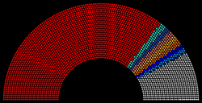
China-Political Parties (y)
Chinese Communist Party
Eight Legally Recognized Parties

Slide 28
China-Legislative Powers
Party-controlled system (China government legitimacy rests on party)
Politburo Standing Committee actual center of state power (leaders of Communist Party)
Standing committee of the NPC actually assumes legislative duties most of the year (when NPC not in session)
sets NPC agenda
Supervises NPC elections
Interprets Constitution and laws
Unicameral
Constitution recognizes as governments most powerful institutions
Elects president
Approves premier
Passes legislation
Approves presidential actions
Legitimizes policies of the executive

